Slide 1
Housekeeper
Scheduling System

Slide 2


Slide 3
TEAM MEMBERS
2498583 | Soumyajit Banerjee
2498609 | Shivam Kailas Dumbare
2498926 | Sumit kumar Saha
2498816 | Shubham Bharat Gore
2498882 | RAVICHANDRA N
2498700 | Pragati Sopan Mohite
2498845 | Bhagyavanth X
2498626 | Pilla Roopa
2498934 | Gavvala Anil
2498465 | ALAMURU CHANDANA PRIYANKA
FRONT END
FRONT END

Slide 4
INTRODUCTION​
Design an application which hostel students can use to get their rooms cleaned on time. The current management system found it difficult to schedule cleaning services
As a result, the team decided to hire a Full Stack developer who could develop an online housekeeping scheduling system with a rich
and user-friendly interface.

Slide 5
ABSTRACT​
Our application is to create a dynamic and responsive Java application to allow a user to register to the application and search for Housekeeper online.

Slide 6
MODULES FOR HOUSEKEEPER SCHEDULING SYSTEM
ADMIN MODULE
USER MODULE

Slide 7





TECHNOLOGIES USED :
Front-end : Angular​
Server-side: Spring Boot​
Back-end: MYSQL, Hibernate​
Server: Tomcat
Testing : Postman

Slide 8
ADMIN
Admin will be able to :
Login to the portal
Admin select housekeeper and allocate
Admin can add, edit, delete housekeeper details.
Maintain the feedback of the user.

Slide 9
USER
User will be able to :
Register to the application
Sign in to the application
Update profile , password change
Send housekeeper request to admin
Can also sending a feedback

Slide 10
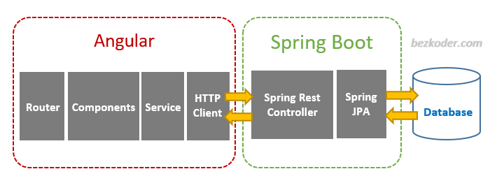
Project Architecture

Slide 11
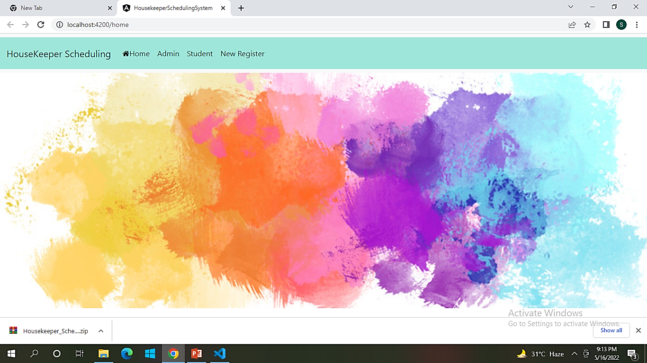

Slide 12
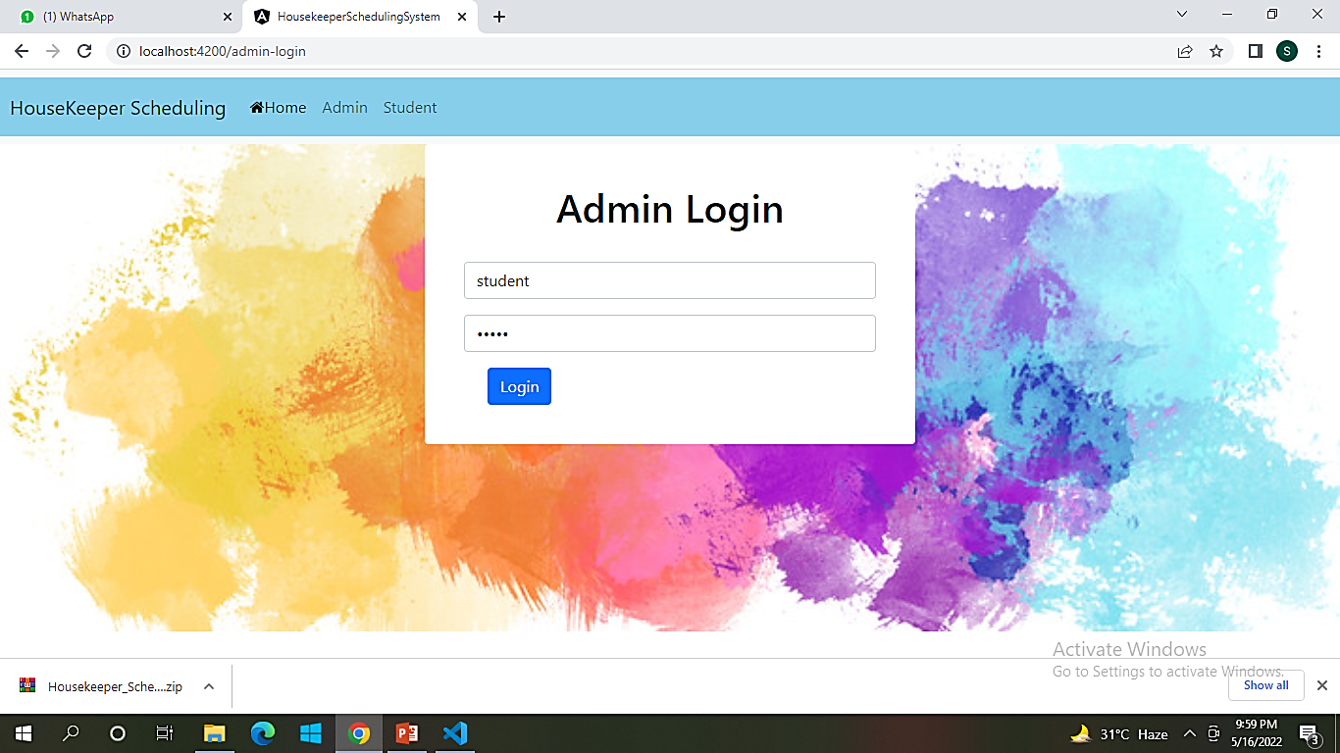

Slide 13
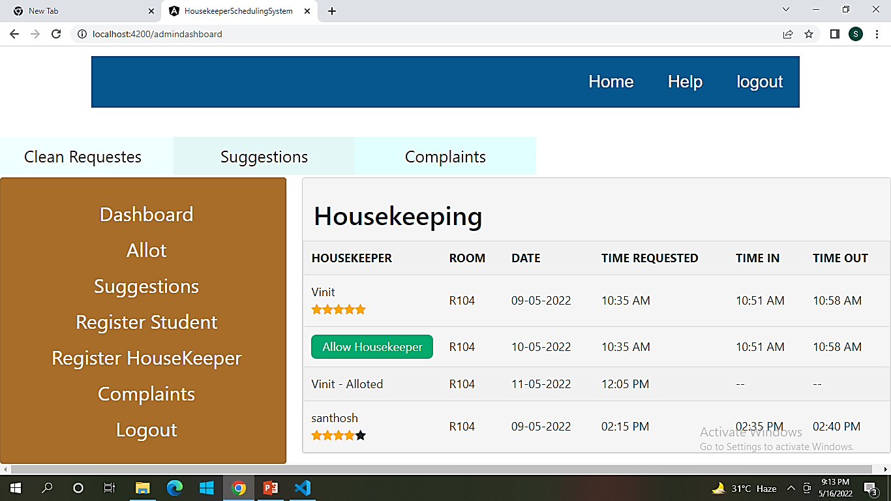

Slide 14
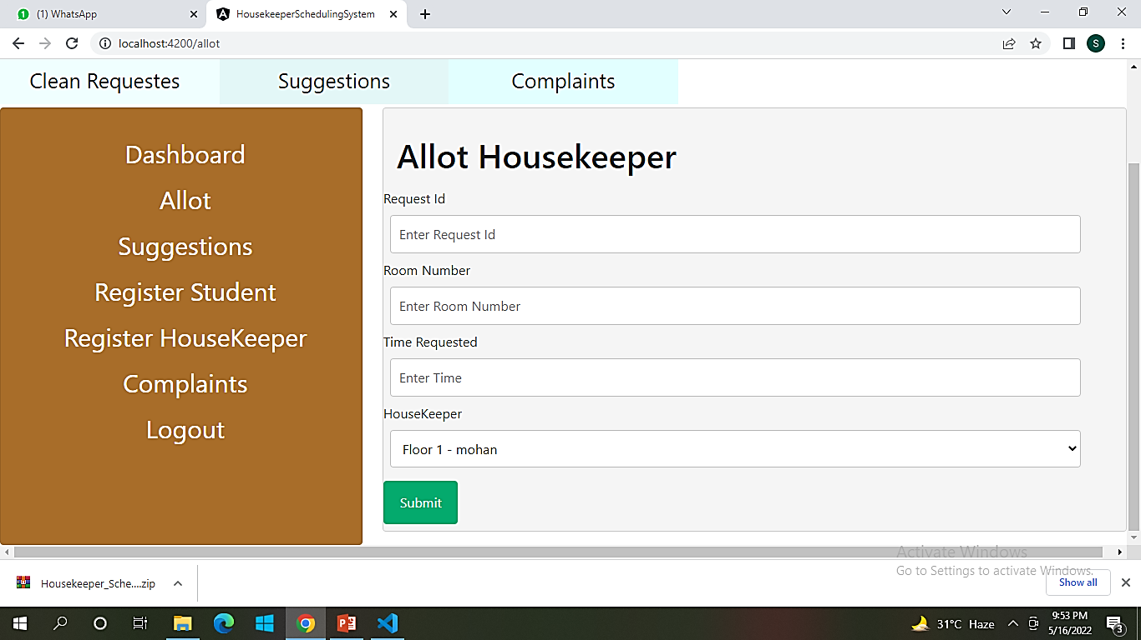

Slide 15
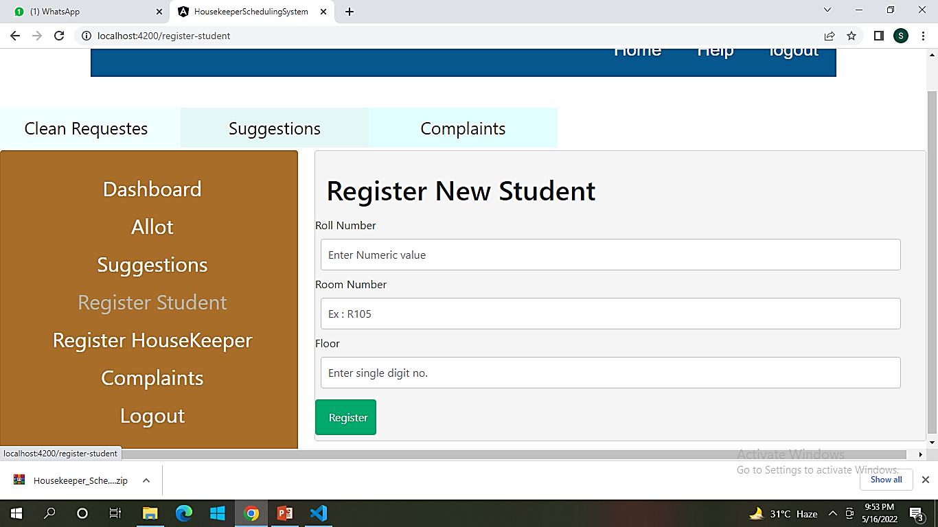

Slide 16
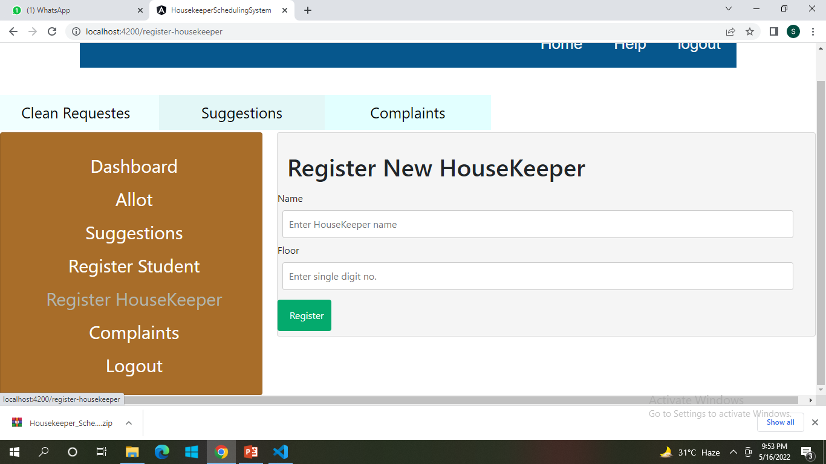

Slide 17
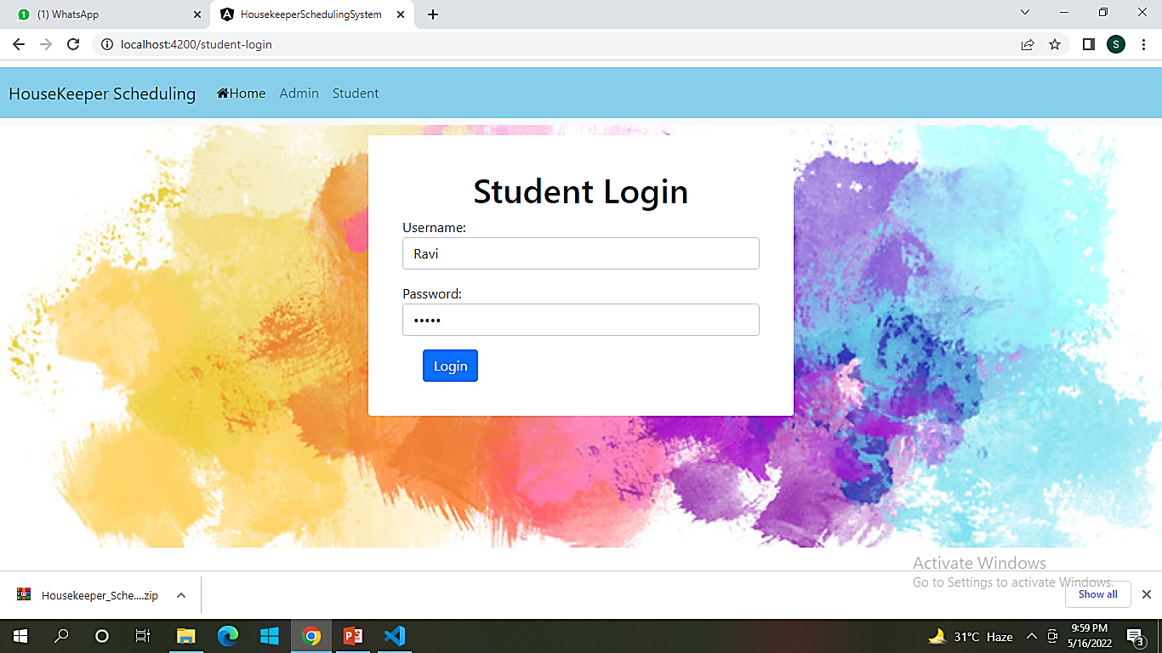

Slide 18
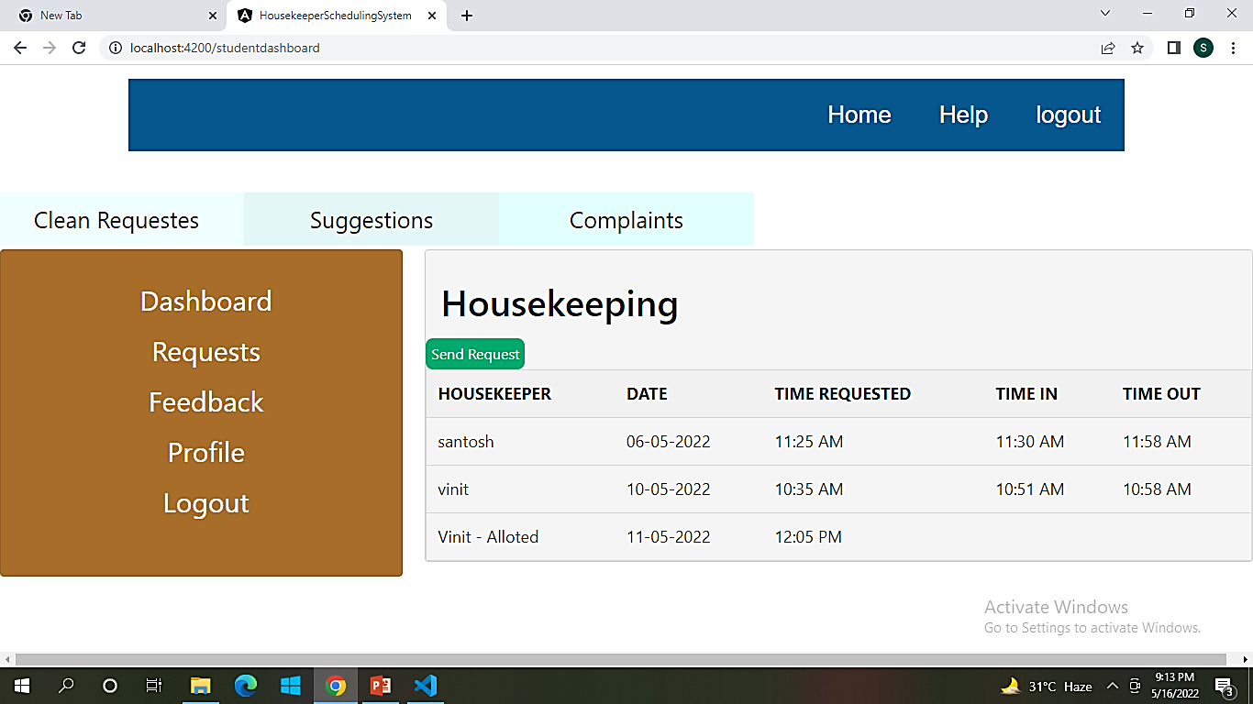

Slide 19
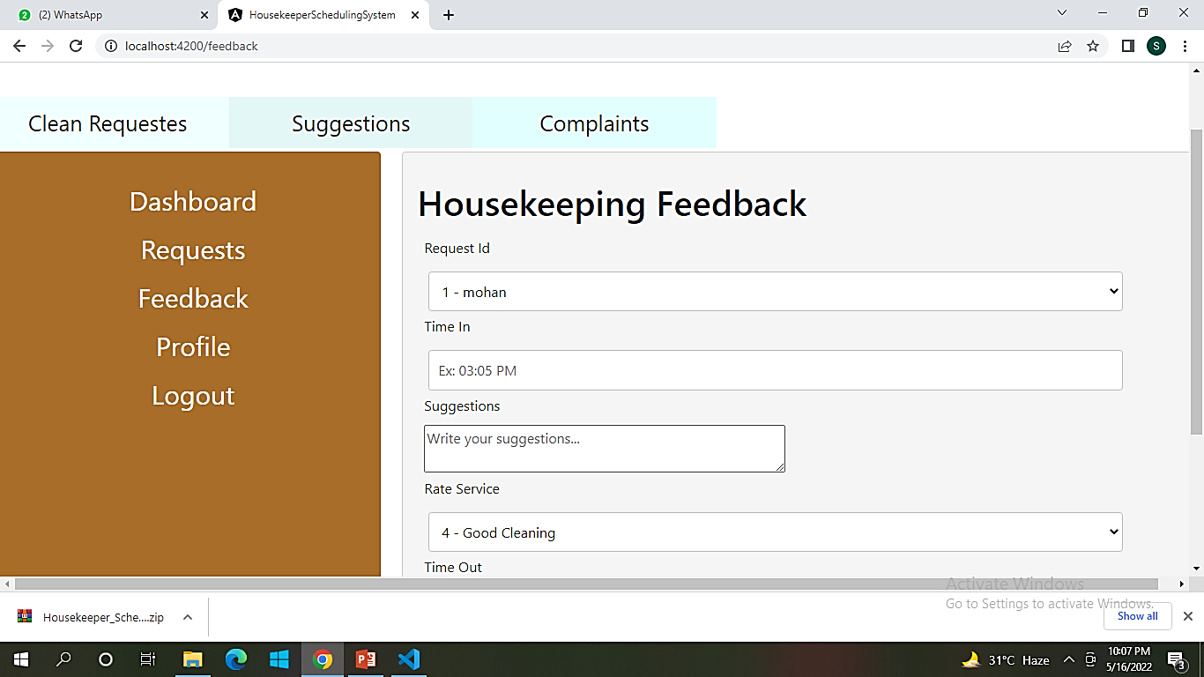

Slide 20
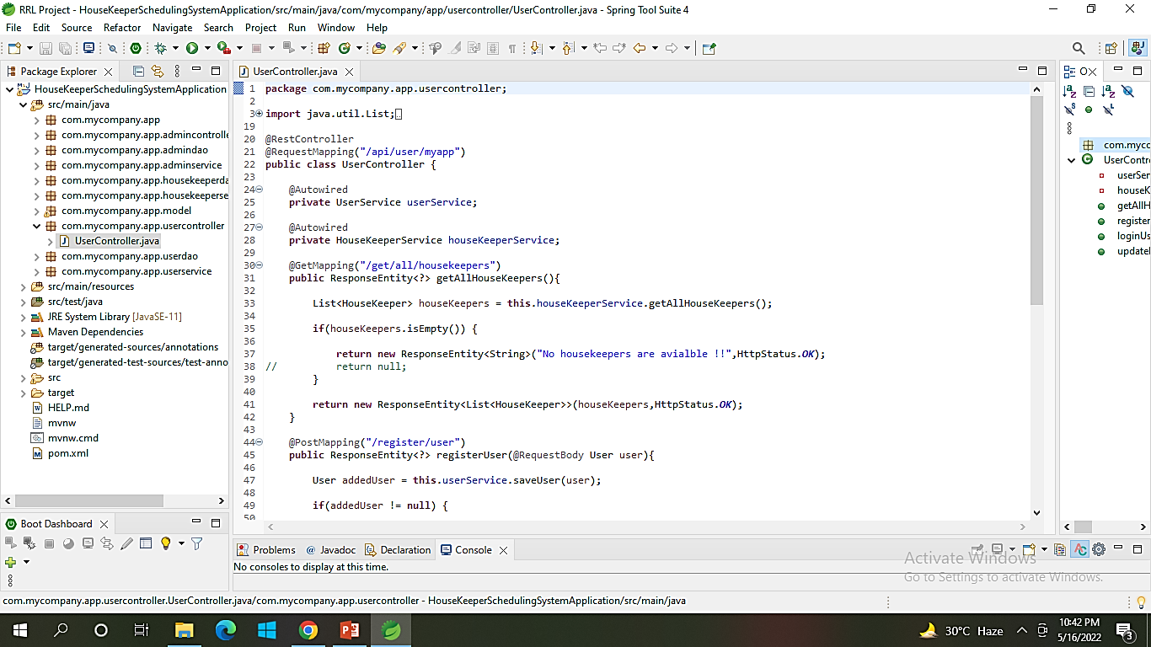

Slide 21
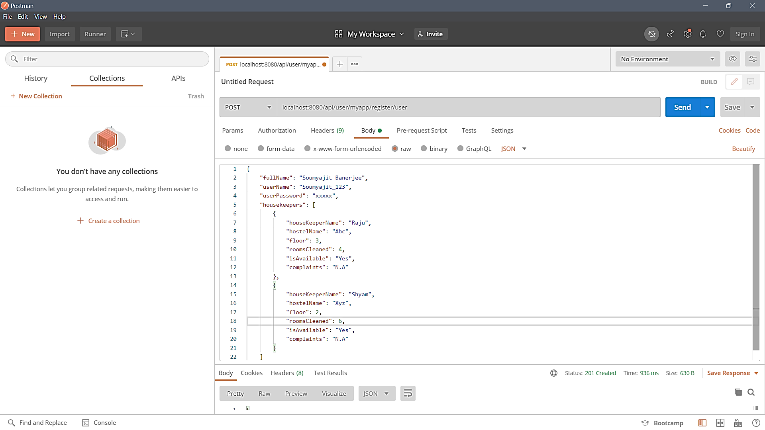

Slide 22
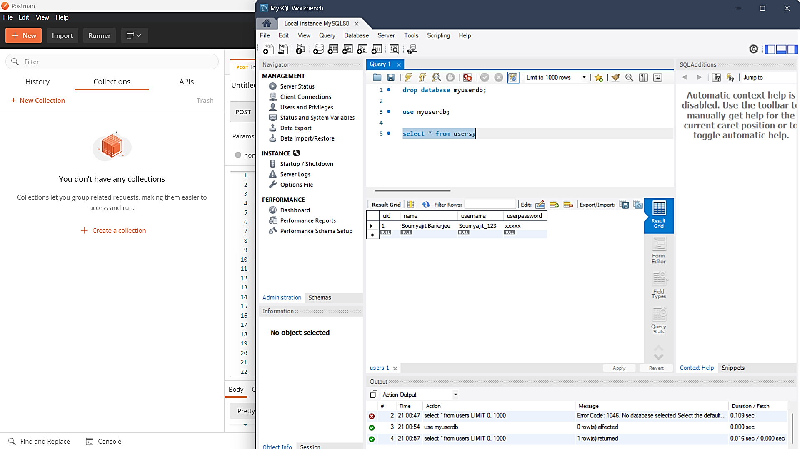

Slide 23
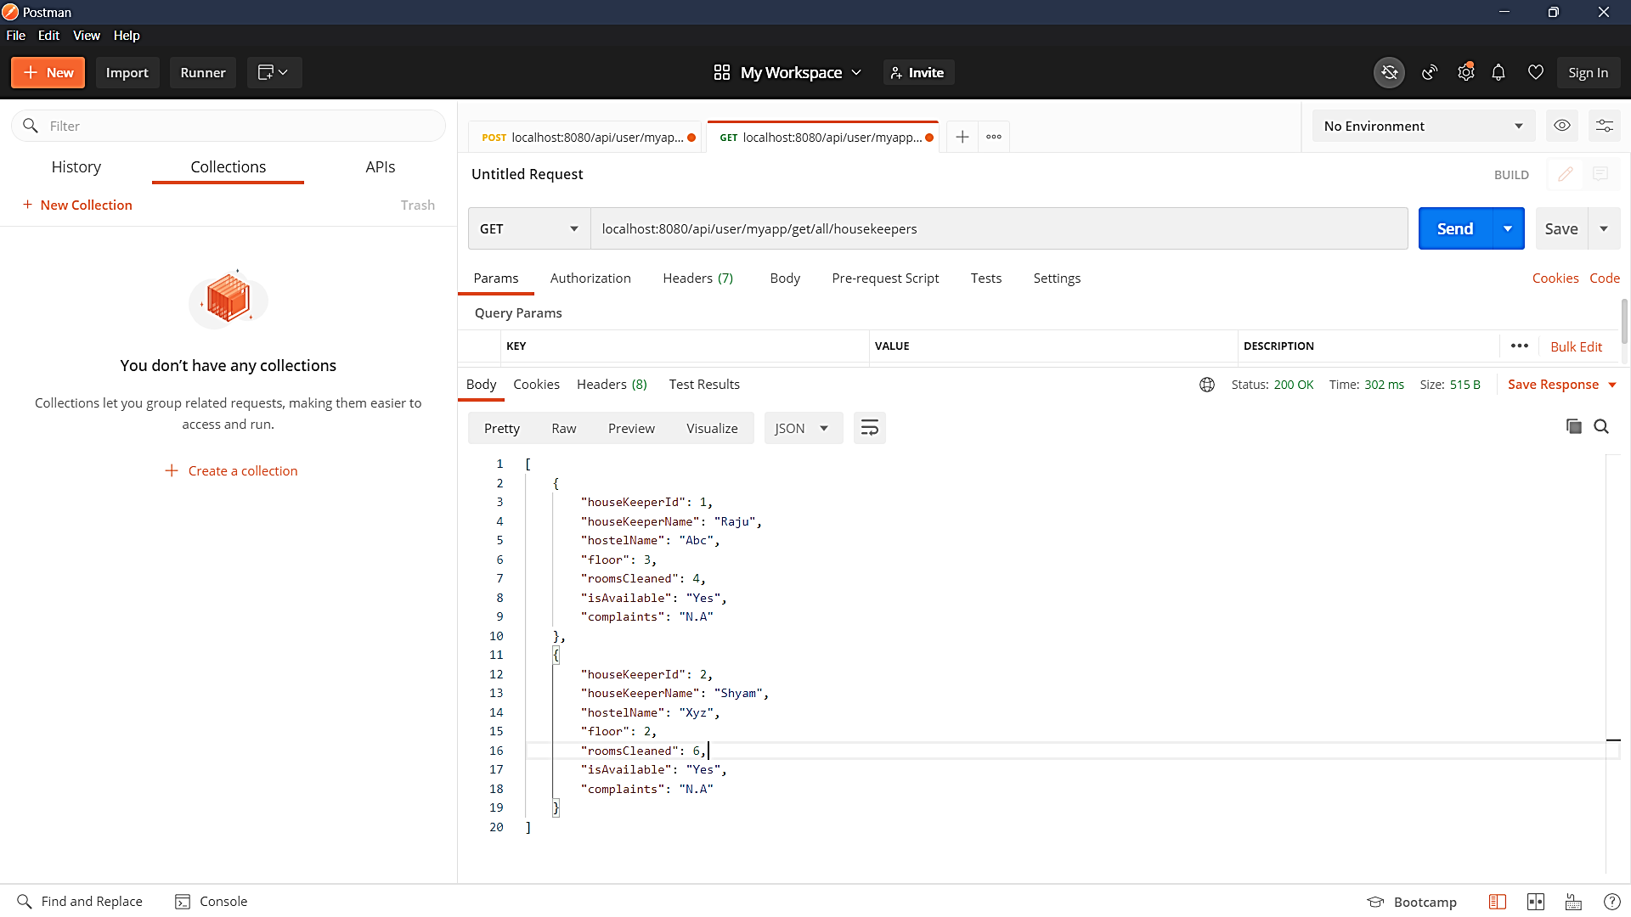

Slide 24
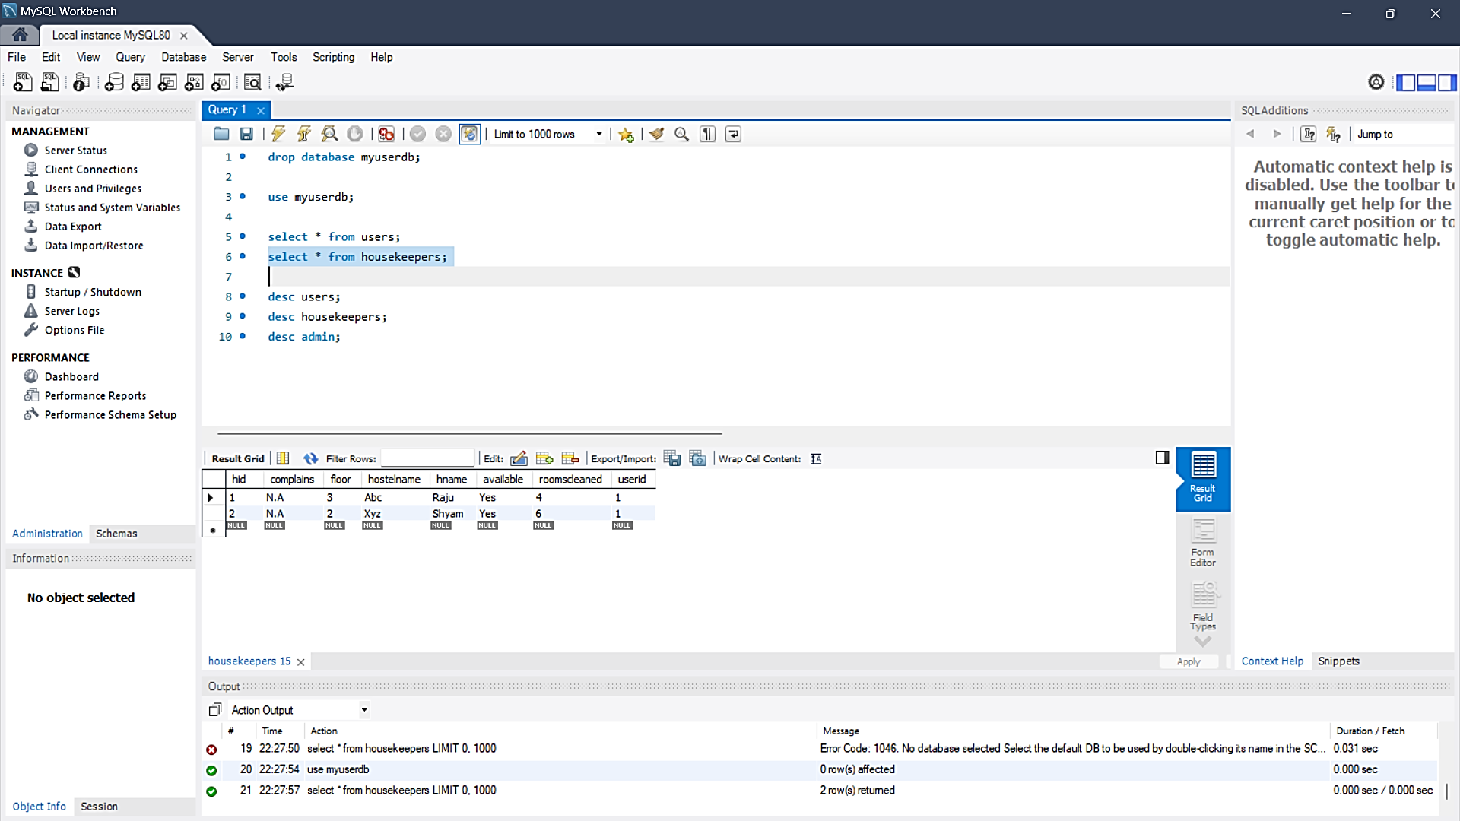

Slide 25
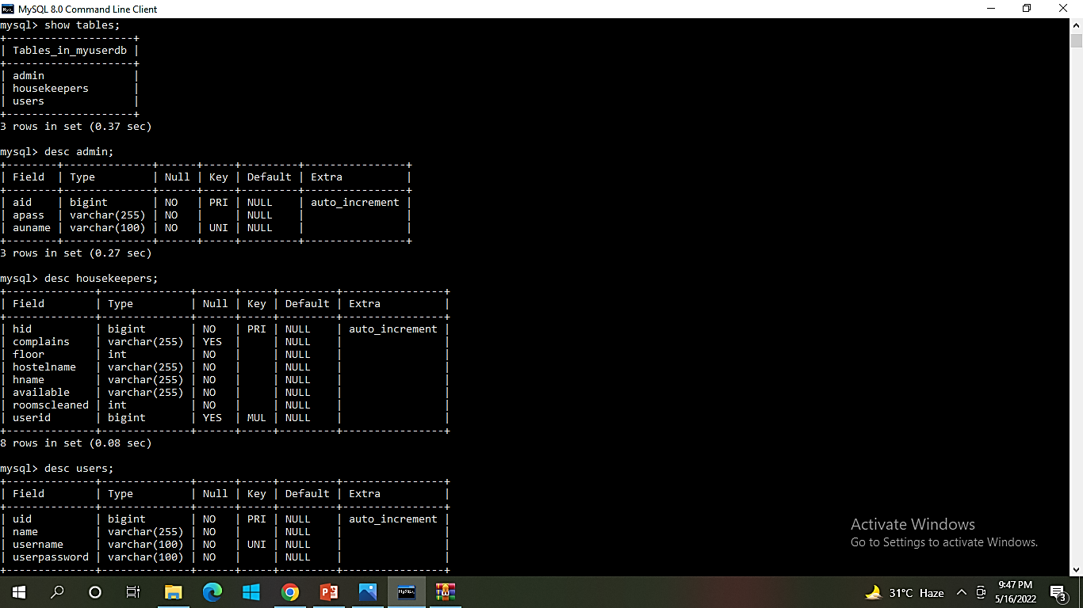

Slide 26
ADVANTAGES This system is very easy to understand and user friendly. Student and hostel warden are connect with each other on one system. This system is saving the time for student and hostel warden too. It ensures the privacy of the users data and secures its access in the database and the maintenance of the application is also easy.

Slide 27
FUTURE WORK We are looking forward to update this project by adding the Connection functionality and the all the overall functionality of allotting and releasing a housekeeper for a specific period of time

Slide 28
CONCULSION
The main objective of the application is to understand the concept and implementation of Java, Spring Boot, Databases and Angular technology.

Slide 29

THANKYOU

